Slide 1
IBM University Engagement Project Submission
EXPLORING THE POWER OF AI WITH IBM

Slide 2

Project Title-[FITNESS BUDDY]
DOMAIN OF PROJECT -[ HEALTH CARE]
Recent Passport size photograph
Email id – ananyatiwari850@gmail.com
Mobile number - 8707255750

Slide 3
Problem Statement
Problem Statement: Fitness Buddy AI
The Challenge
Many people struggle to maintain a healthy lifestyle due to a lack of personalized fitness guidance, proper workout planning, balanced nutrition advice, and progress tracking. Existing solutions are often generic and fail to provide recommendations tailored to individual goals such as weight loss, muscle gain, or maintaining fitness.
The Objective
Build an AI-Powered Fitness Buddy that provides personalized health and fitness guidance using IBM watsonx.ai.
The solution should:
Generate personalized workout plans
Recommend healthy meal suggestions
Calculate BMI and health status
Answer fitness and nutrition-related questions
Support family profile management
Provide motivational health guidance
Maintain an interactive AI chat experience
Deliver safe and personalized recommendations

Slide 4
Proposed Solution
Proposed Solution: AI-Powered Fitness Buddy
Fitness Buddy AI is an intelligent web application developed using Python Flask and IBM watsonx.ai models. It provides personalized fitness and nutrition guidance through an interactive AI assistant.
The application allows users to:
Generate customized workout plans based on their goals.
Receive healthy meal recommendations.
Calculate Body Mass Index (BMI).
Manage multiple family health profiles.
Ask fitness, exercise, and nutrition-related questions in natural language.
Get motivational and health improvement suggestions.
The frontend is responsive and user-friendly, providing a smooth chat experience across devices. IBM watsonx.ai powers intelligent response generation while IBM Cloud provides a secure deployment environment.
Overall, Fitness Buddy AI acts as a smart virtual fitness assistant that helps users adopt healthier habits through personalized AI guidance.

Slide 5
Technology Used
Python Flask – Backend web framework.
HTML5, CSS3 & JavaScript – Responsive frontend development.
IBM watsonx.ai – AI model deployment and inference.
META LLAMA Models – Natural language understanding and response generation.
IBM Cloud – Secure cloud deployment.
REST APIs – Communication between frontend and backend.
Git & GitHub – Version control and project management.
Render – Cloud hosting and deployment.

Slide 6
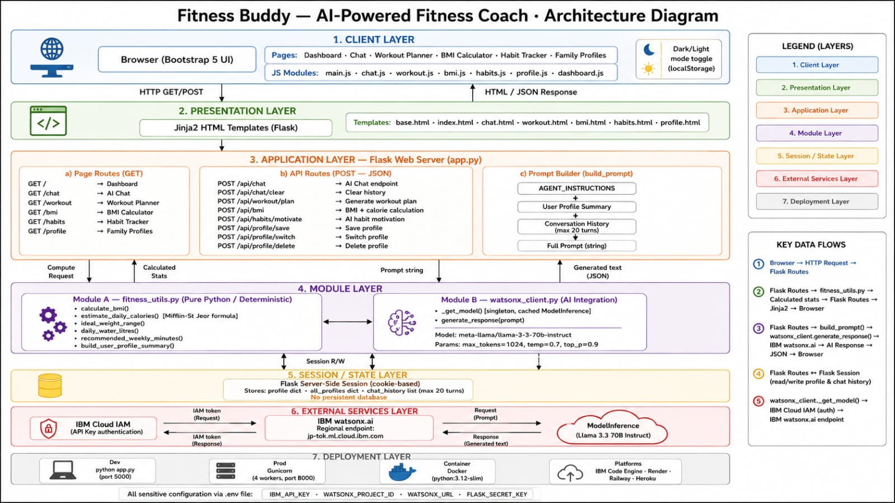

Slide 7
Role of AI in the Solution
Role of AI in Fitness Buddy AI
Fitness Buddy AI uses IBM watsonx.ai with the Meta Llama model to provide intelligent and personalized fitness guidance. Instead of giving predefined responses, the AI understands user queries and generates context-aware recommendations in real time.
The AI analyzes user inputs such as age, height, weight, BMI, fitness goals, and dietary preferences to create customized
workout routines and healthy meal plans. It also answers fitness and nutrition-related questions, explains exercises, and
provides practical health suggestions.
The chatbot maintains a natural conversation, allowing users to ask follow-up questions and receive relevant, personalized responses. It also encourages users with motivational guidance and healthy lifestyle tips to improve consistency and
overall well-being.
Overall, AI makes Fitness Buddy AI an intelligent, interactive, and personalized virtual fitness assistant that helps users make informed decisions and achieve their health and fitness goals more effectively.

Slide 8
Novelty and Uniqueness
Fitness Buddy AI combines artificial intelligence with personalized fitness guidance to deliver a complete health assistant.
Key Features :
Personalized workout recommendations.
AI-generated healthy meal suggestions.
BMI calculation with health interpretation.
Family profile support.
Interactive AI chat powered by IBM Granite.
Responsive and modern user interface.
Secure cloud deployment using IBM Cloud.
Real-time personalized health guidance.
Beginner-friendly and easy to use.
This makes Fitness Buddy AI a practical and intelligent digital fitness companion suitable for everyday users.

Slide 9
GitHub Link
GitHub Repository - https://github.com/AnanyaTiwari850/Fitness-Buddy-AI
Repository includes:
Source Code
README.md
requirements.txt
app.py
templates
static
Presentation (PPT)
LIVE LINK - https://fitness-buddy-ai-fvxj.onrender.com
LinkedIn Post Link – https://www.linkedin.com/posts/ananya-tiwari-28a9b6346_my-latest-ai-project-fitness-buddy-ugcPost-7481749371307343873-NP-r/?utm_source=share&utm_medium=member_android&rcm=ACoAAFalMQoBJDIrqL4W73T39y4jzw5NI8URup4
( THIS LINKEDIN POST HAVE POST ABOUT PROJECT AND VIDEO)

Slide 10
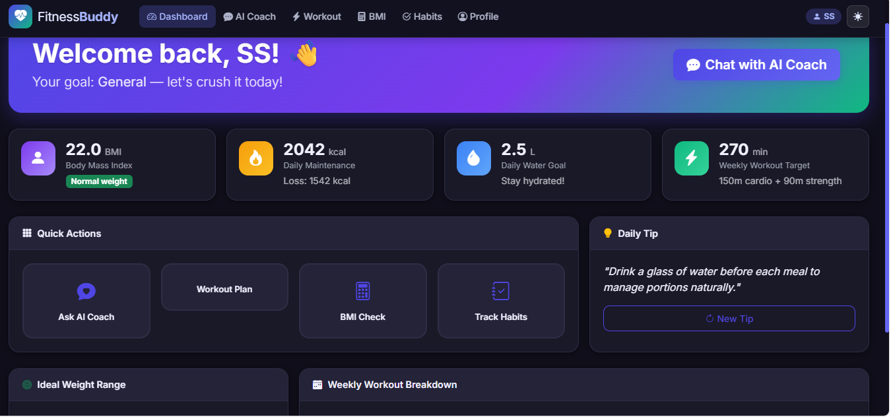

Slide 11
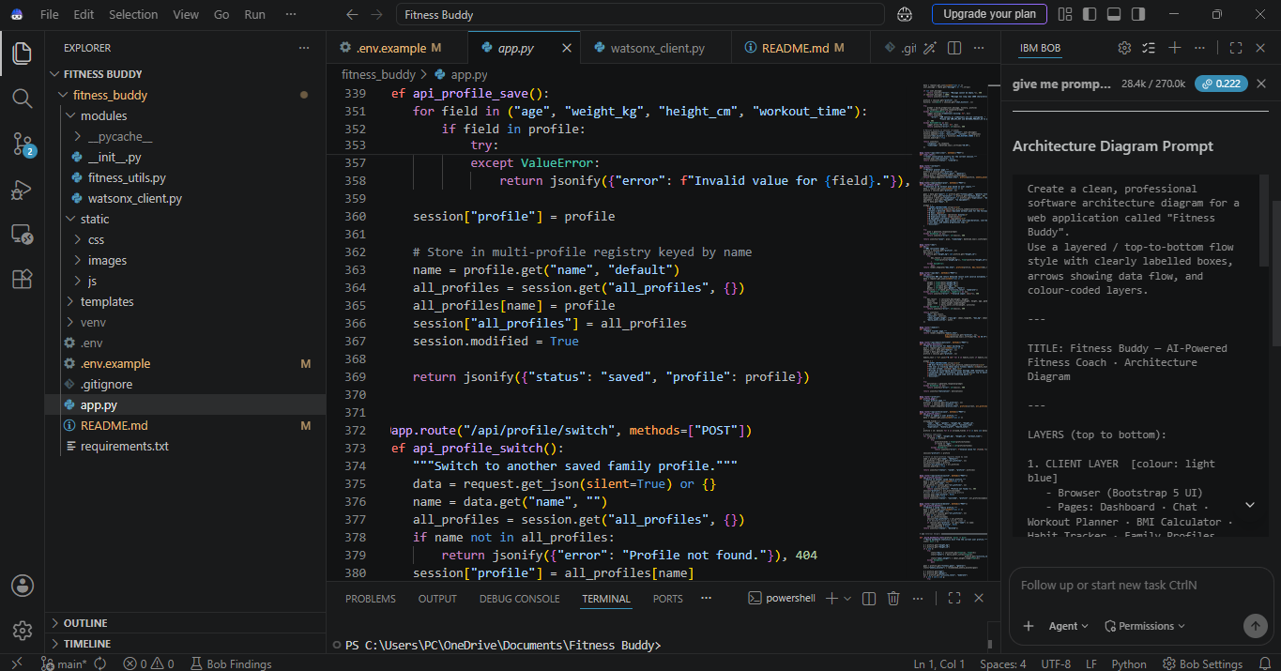

Slide 12
FUTURE SCOPE
1. Wearable Device Integration
Integrate smartwatches and fitness bands to collect real-time health data such as heart rate, calories burned, steps, and sleep patterns.
2. Voice Assistant Support
Allow users to interact with the application using voice commands for a more natural experience.
3. Multilingual Support
Provide fitness guidance in multiple languages to improve accessibility.
4. Advanced Health Analytics
Introduce dashboards with charts showing workout consistency, calorie intake, BMI trends, and overall health progress.
5. Personalized Goal Tracking
Enable users to set fitness goals and monitor their daily, weekly, and monthly progress.

Slide 13
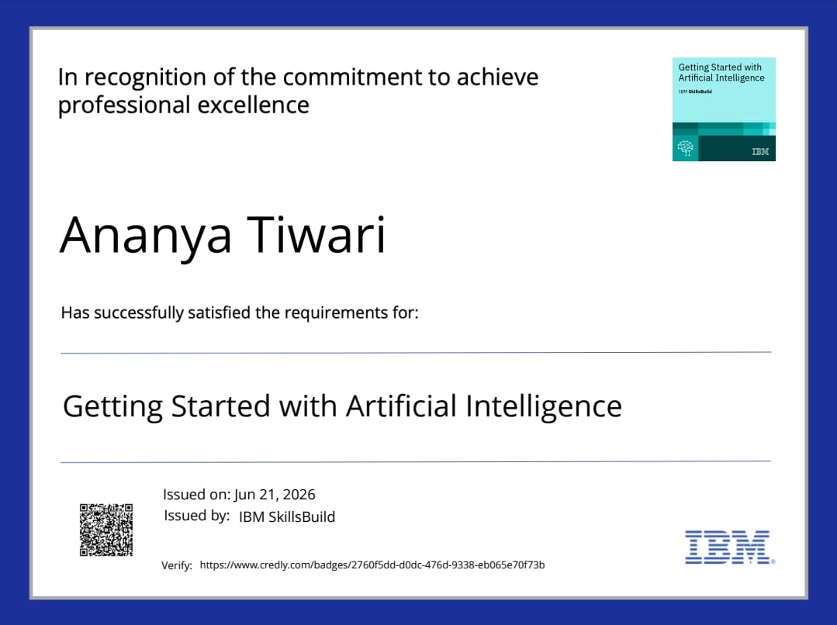

Slide 14
